Slide 1
Biola Buddy
Derek James, Matt Robles, Ryan Tsukamoto, Jiahui Jiang

Slide 2
Biola Buddy Features
Chimes articles
Auto-updates of the newest articles posted on chimes website.
Categorize articles according to different contexts
Interactive map
Full-screen map that helps to navigate directions on-campus
Chapel Schedule
Display the weekly chapel schedule
Includes times, location, and speaker
Restaurant hours and menus
Display on-campus restaurant options
Display the menu of restaurant

Slide 3
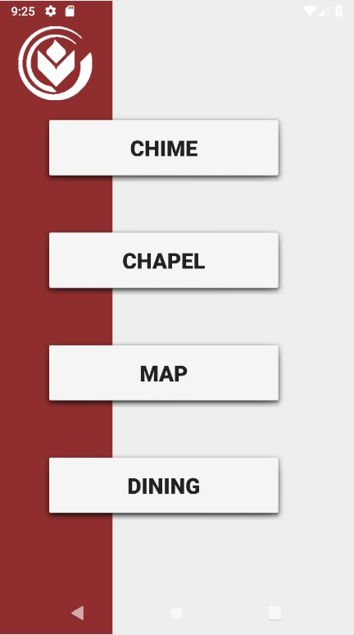
Main Menu

Slide 4
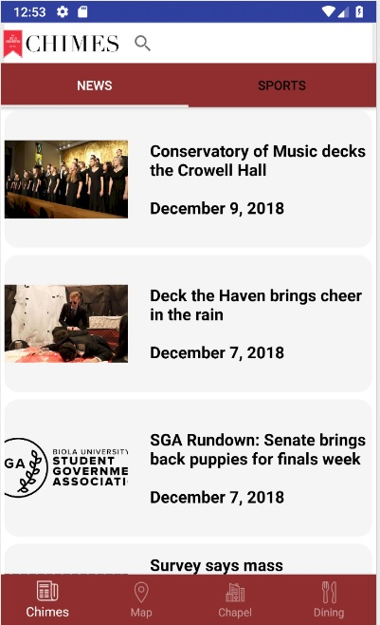
Chimes

Slide 5
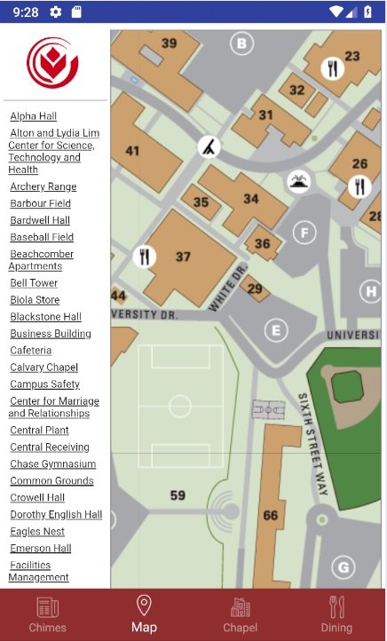
Map

Slide 6
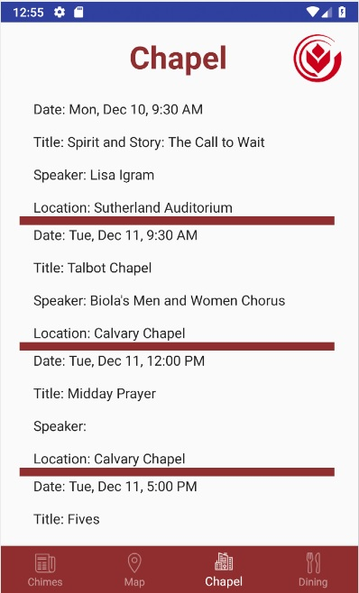
Chapel Schedule

Slide 7
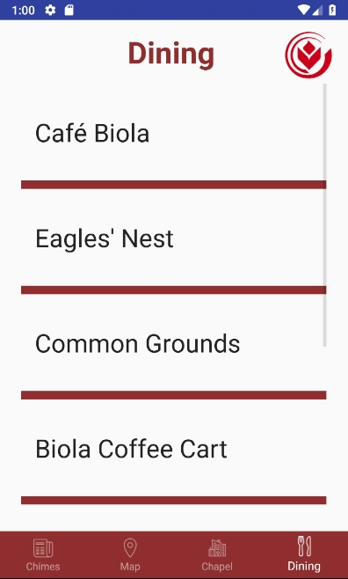
Dining

Slide 8
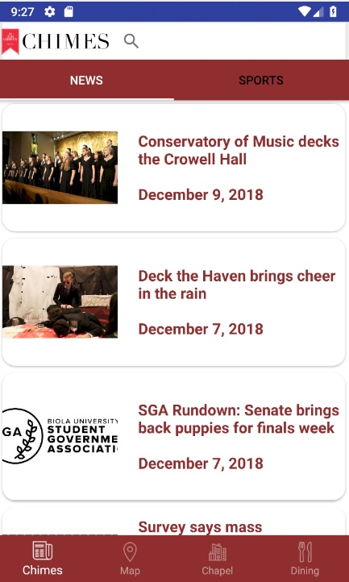
Design Methodologies of Biola Buddy
Simplicity:
No non-essential elements
Easy to Use
Easy to Understand
Error-Free
Effective Product
Visibility
Response time: since one key element to our app is
Internet, the only delay comes from Biola’s backend.
We have our own progress bar on the splash screen.
Tabs changes color when selected
Constraints:
We tried to use constraint layout as much as possible
Application is centered around the user and usability

Slide 9
Material Design of Biola Buddy
Colors:
Primary Color - Biola Red
Secondary Color - White, black
Text:
Content titles are bolded, ListView items are bolded,
Text Colors are black
Screen:
Loading screen and home screen are full screen to give
users a better feeling of engagement
We did no chose to full screen all activities because
we considered users might need the time and the battery percentage of their device.

Slide 10
Material Design of Biola Buddy
Icon:
Biola icon is the main icon that we use for this app.
There are two separate versions of it.
Usability:
Minimal bugs and issues regarding performance
Fully functional and user-ready.
Accessibility:
All images have content descriptions
Clickable elements are all visible and has sufficient
contrast and size

Slide 11
Usability
Learnability:
All buttons are self-explanatory and are in the places
that they need to be
According to feedbacks from our testings, new users
stated where the button looks like will take you to
UI designs are clean and consistent
Memorability:
Because of the simplistic design, returning users should
be able to pick up the interface fairly quickly.

Slide 12
Usability
Efficiency:
Most onclick listeners are set to ImageViews, TestViews,
or ListItems, so it is easy to click.
We’ve implemented a navigation bar at the bottom
of every page for easier access to other pages.
Additionally, we’ve added back buttons on every page, enabling
for faster navigation and increased design elements.
Satisfaction:
In its entirety, the app is effective and pleasing to the eye.

Slide 13
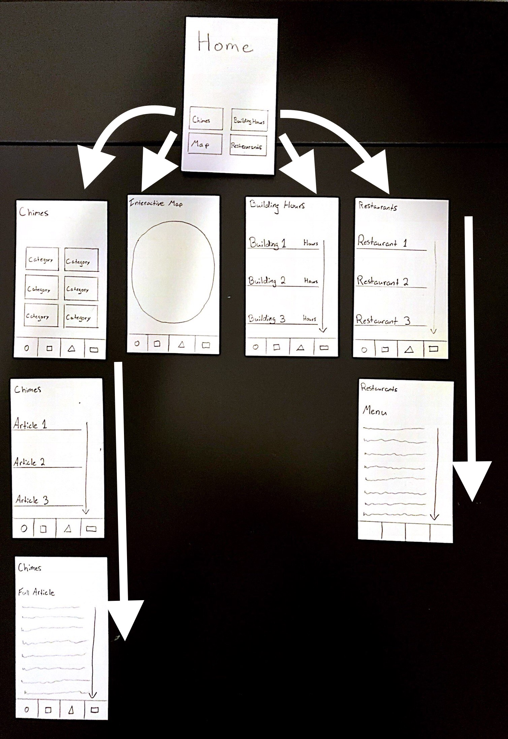
Low Fidelity Prototype
(Wireframe)

Slide 14
Low Fidelity Prototype
User Testing and Feedback
Users liked layout and flow of activities
Users wanted a title bar that stands out more
Users did not like the word “restaurants” and recommended “eateries”, or “dining” instead.
Users recommended to make the food section red
Users desired a fullscreen map
Users recommended that we include weather
Some users requested a department contact info
Users requested a search bar for the Chimes page

Slide 15
Low Fidelity Prototype
Features
Chimes articles
Auto-updates of the newest articles posted on chimes website.
Categorize articles according to different contexts
Able to search articles according to their titles.
Interactive map
Full-screen map that helps to navigate directions on-campus
Opens other map app if entered off-campus address
Building hours.
Display all building hours on-campus and contact info of different departments
Display local daily weather
Restaurant hours and menus
Display on-campus restaurant hours
Display the menu of restaurant

Slide 16
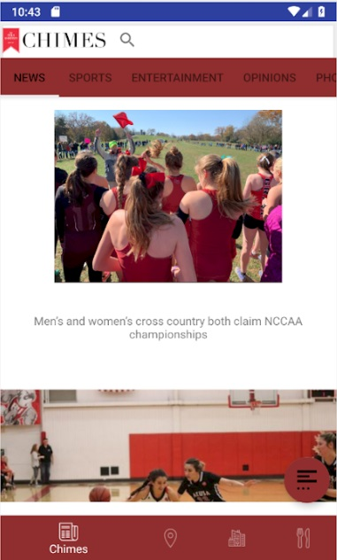
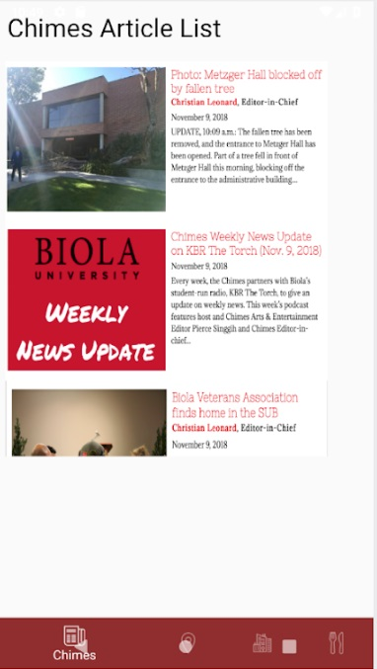
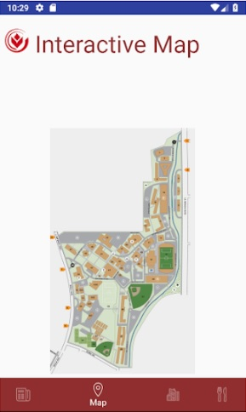
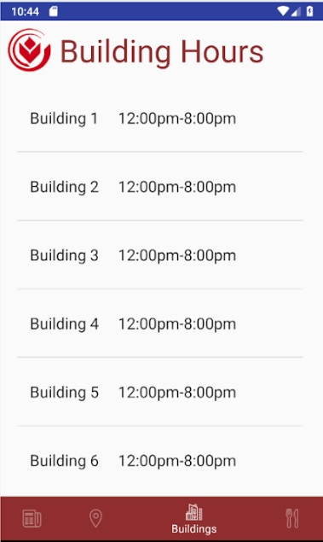
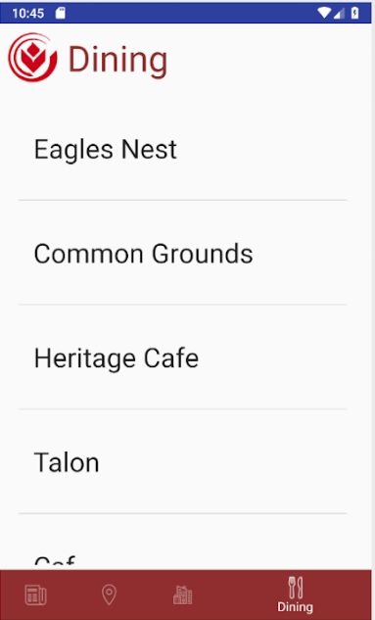
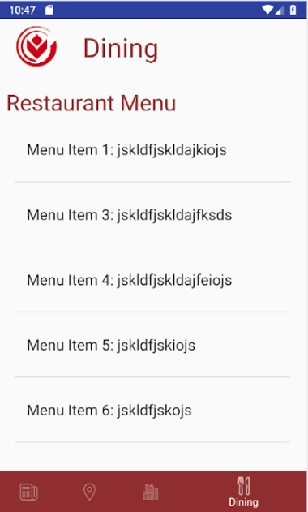
High Fidelity Prototype
Chimes
Map
Chapel
Dining

Slide 17
High Fidelity Prototype
Participant Evaluation #1
Interface: The interface is pretty simple to use and quite friendly looking. It is pretty clear as to where to find what I want to find. Functionality: It was quite functionable. Some links are not added in yet, but it is easy to understand what the app was trying to do. Navigation & Task Flow: Navigation was good. The tabs located at the bottom of the page really made it easy to navigate through the app. Terminology Used: Terminology was very self explanatory and was easy to understand. The “read more” button was different, but after using it a few times it was very helpful. Screen Contents: Everything was consistent within each screen content. Screen Layout: Screen layout was quite simple. Could be a little brighter but overall quite functionable. Colors/Fonts/Icons: Use of school colors was a good idea. Fonts were normal. Icons were very nice and easy to understand. Good color choices: Could use a little bit more color to enhance the quality. Efficiency: Pretty efficient with getting from one tab to another. Overall very user friendly.

Slide 18
High Fidelity Prototype
Participant Evaluation #2
Interface: The interface is plain, but efficient. It is easy to switch tabs from one tab to another, and I also don’t have to wait for too long for the different tabs to load. Functionality: All the functions seem like they could work. Navigation & Task Flow: The Navigation of the lower tabs is relatively slower than the upper tabs in the Chimes section, but still functional. Terminology Used: The application is descriptive in the terms it uses, and I think that the terms cover most of the important assets an informative app should have. Screen Contents: The app provides a variety of screen contents such as pictures and tabs that you could click on. Screen Layout: The content layout is relatively simple, but slightly too plain. Could work on some of the aesthetic aspect. Colors/Fonts/Icons: Good color choices representing Biola’s colors. Efficiency: Efficient use of space with the pictures on the Chimes page, and switching tabs from Chimes to Map to Buildings to Dining take a long time considering it’s an app.

Slide 19
Our Response to Participant Evaluation
Missing or broken features: We understood that we still had some serious time to invest in the application. There was a good amount of functionality that was missing. Implementing missing features and optimizing inefficiencies became our top priority after reviewing our user feedback.
Revisions: Users requested that we replace building hours with chapel hours. We immediately responded, implemented chapel hours, and changed our layout to support it.e
Design: We were flattered to hear a good amount of positive feedback on our user interface. Our main goal was to create a Biola application that is aesthetically pleasing, easy to use, and useful in many ways. We contemplated the suggestion on color changes, but for the sake of simplicity, we decided it was best to constrain our choice of colors. Likewise, we optimized response time, transitions, and added features to enable faster user navigation.

Slide 20
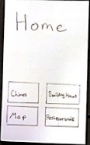
Home Screen Progression
Low Fidelity
Finished Product

Slide 21
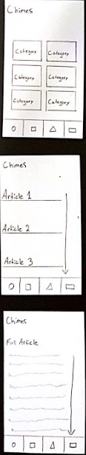
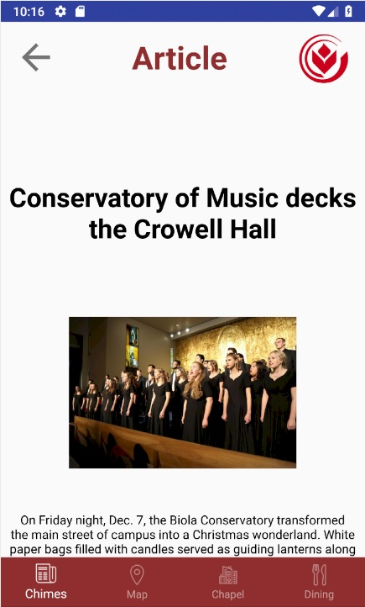
Chimes Progression
Low Fidelity
High Fidelity
Finished Product

Slide 22
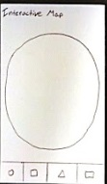
Map Progression
Low Fidelity
High Fidelity
Finished Product

Slide 23
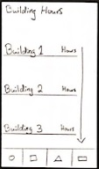
Chapel Schedule Progression
Low Fidelity
High Fidelity
Finished Product

Slide 24
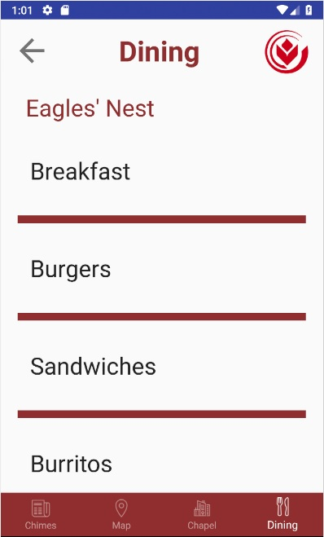
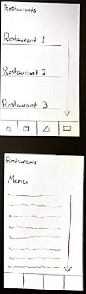
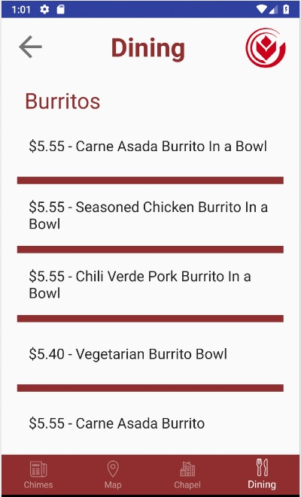
Dining Progression
Low Fidelity
High Fidelity
Finished Product

Slide 25
Team Contribution
Derek: Accessibility, Project Management, Marketing, User Research, Usability Testing
Matt: Change Management, Information Architecture, Content Strategy, Subject Matter Expertise
Ryan: Enterprise Architecture, Metrics Analysis, Technical Development, User Interface Design
John: Business Analysis, Interaction Design, Quality Assurance, Visual Design

Slide 26
Additional Testimonials from our Users
“You know before I tested this app, I’ve never even heard of the Chimes; now I know what’s going on around campus.” - Ava B.
“Biola Buddy has never failed me once.” - David G.
“I now have the app I’ve always wanted. Very easy to use and understand!” - Josh D.
“Impressive app design! Very easy to use.” - Lenny B.
“Biola Buddy is game changing, It’s so easy to find classes and know what’s going on.” - Sarah L.
“This app is off the chain.” - Darius M.
“I couldn't quite figure out where the library was when I came into Biola as an incoming senior. The campus is really big and hard to navigate through. This app has everything I needed! 10/10
- Thomas K.

Slide 27
Demonstration:

